Slide 1
MCMC for Cryptography

Slide 2
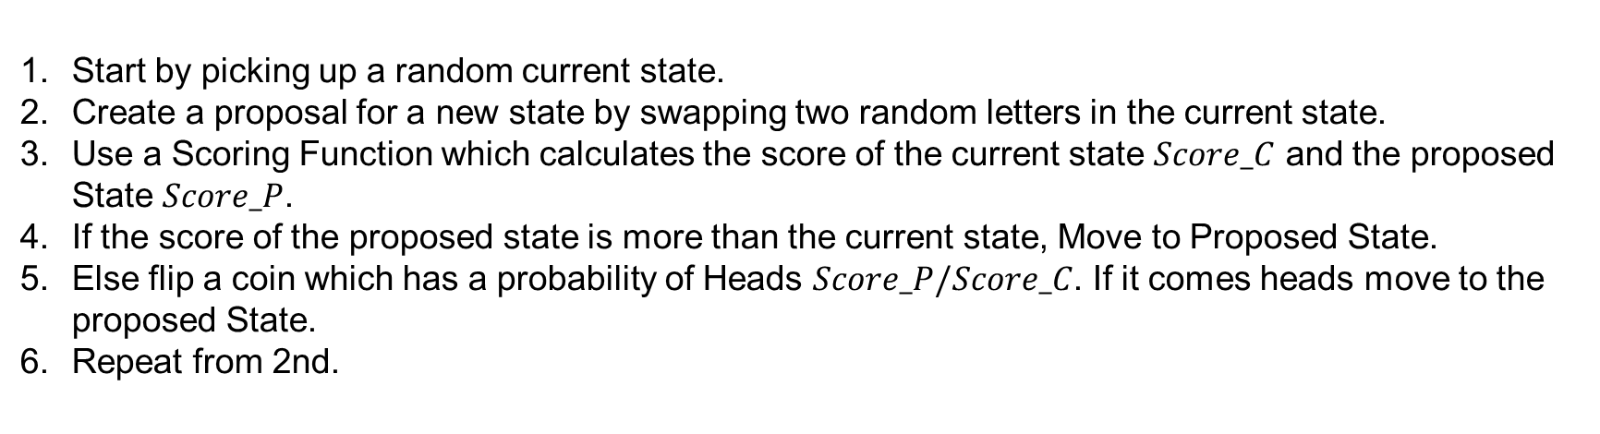
Steps for MCMC
Start by picking up a random current state.
Create a proposal for a new state by swapping two random letters in the current state.
Use a Scoring Function which calculates the score of the current state $Score_C$ and the proposed State $Score_P$.
If the score of the proposed state is more than the current state, Move to Proposed State.
Else flip a coin which has a probability of Heads $Score_P/Score_C$. If it comes heads move to the proposed State.
Repeat from 2nd.

Slide 3
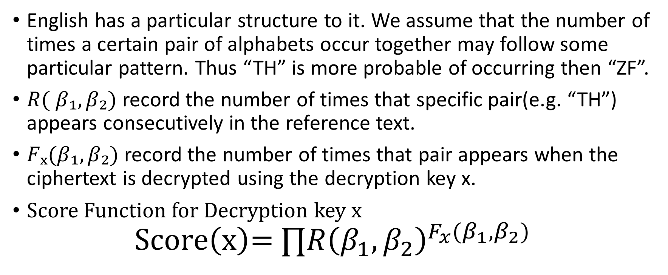
Scoring Function
English has a particular structure to it. We assume that the number of times a certain pair of alphabets occur together may follow some particular pattern. Thus “TH” is more probable of occurring then “ZF”.
$R( β₁,β₂)$ record the number of times that specific pair(e.g. “TH”) appears consecutively in the reference text.
$Fₓ(β₁,β₂)$ record the number of times that pair appears when the ciphertext is decrypted using the decryption key x.
Score Function for Decryption key x
$$\text{Score}\left(\text{x}\right)\text{= }∏R{\left(β_{1},β_{2}\right)}^{F_{x}(β_{1},β_{2})}$$

Slide 4
Tasks
You will need to implement a python program that reads the ciphertext from a file named “ciphertext.txt” and save the plaintext into a file named “plaintext.txt”
A template will be given and you can follow the template or design your own MCMC
For more detail, please reference the given template
Reference text is war_and_peace.txt

Slide 5
Submission
Please zip the directory and upload the .zip file to E3.
Filename format: “YOUR_STUDENT_ID.zip"
Example:
309000000.zip
|- 309000000.py
Note: Don’t include the reference text and ciphertext

